Slide 1
PREDICTING HOUSE PRICES
USING MACHINE LEARNING
ARTIFICIAL INTELLIGENCE
GROUP 5
TEam mEmbERS:
ashmitha.m.N
aswathy.J.S athira.J
athulya.K.S

Slide 2
PROBLEM STATEMENT:
The housing market is an important and complex sector that impacts people's lives in many ways. For many individuals and families, buying a house is one of the biggest investments they will make in their lifetime. Therefore, it is essential to accurately predict the prices of houses so that buyers and sellers can make informed decisions. This project aims to use machine learning techniques to predict house prices based on various features such as location, square footage, number of bedrooms and bathrooms, and other relevant factors.
PROPOSED SYSTEM:
Linear Regression is a supervised machine learning model that attempts to model a linear relationship between dependent
variables (Y) and independent variables (X). Every evaluated
observation with a model, the target (Y)’s actual value is compared to the target (Y)’s predicted value, and the major differences in these
values are called residuals. The Linear Regression model aims to
minimize the sum of all squared residuals. Here is the mathematical representation of the linear regression: Y= a0+a1X+ ε
The values of X and Y variables are training datasets for the model representation of linear regression. When a user implements a linear regression, algorithms start to find the best fit line using a0 and a1. In such a way, it becomes more accurate to actual data points; since we recognize the value of a0 and a1, we can use a model for predicting
the response.

Slide 3
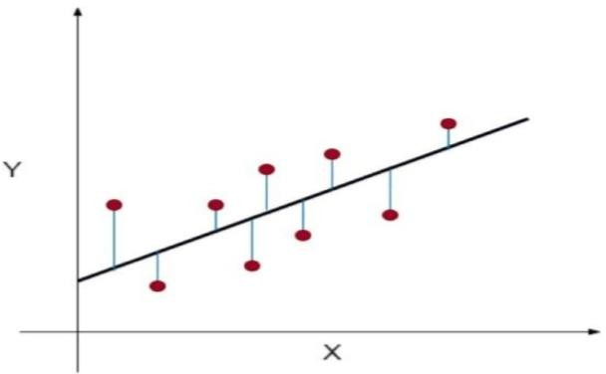
As you can see in the above diagram, the red dots are observed values for both X and Y.
The black line, which is called a line of best fit, minimizes a sum of a squared error.
The blue lines represent the errors; it is a distance between the line of best fit and observed values. The value of the a1is the slope of the black line.

Slide 4
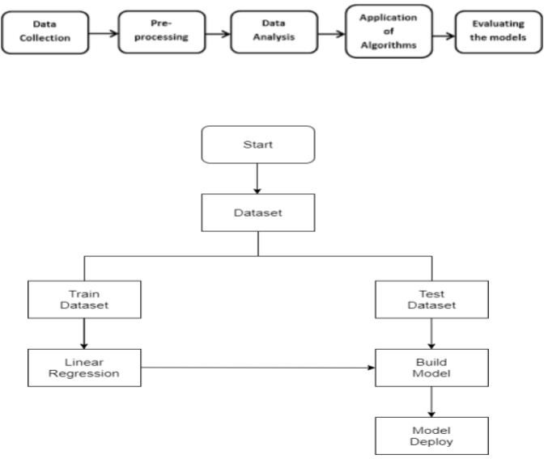
PROPOSED SYSTEM PHASES
Phase 1: Collection of data Data processing techniques and processes are numerous. We collecteddata for USA/Mumbai real estate properties from various real estate websites. The data would be having attributes such as Location, carpet area, built-up area, age of the property, zip code, price, no of bedroomsetc. We must collect the quantitative data which is structured and categorized. Data collection is needed before any kind of machine learning research is carried out. Dataset validity is a must otherwise there is no point in analyzing the
data. Phase 2: Data preprocessing Data preprocessing is the process

Slide 5
of cleaning our data set. There mightbe missing values or outliers in the dataset. These can be handled by data cleaning. If there are many missing values in a variable we will drop those values or substitute it with the average value. Phase 3: Training the model Since the data is broken down into two modules: a Training set and Testset, we must initially train the model. The training set includes the target variable. The decision tree regressor algorithm is applied to the training data set. The Decision tree builds a regression model in the form of a tree structure. Phase 4: Testing and Integrating with UI The trained model is applied to test dataset and house prices are predicted. The trained model is then integrated with the front end using Flask in python.
DATA COLLECTION:
C:\Users\ashmi\Downloads\DOC-20231006-WA0005..csv
STEPS:
First, we predict the values in y using the values in x.
Then we compare the actual prices and predicted prices by using scatter plot.
Then we find the r square error and mean square error between them.
If the error is less enough then we proceed for testing of the model since the training phase is over.

Slide 6
Data Analysis and Feature Extraction:
Machine learning
models can process large datasets containing information about houses, including features like square footage, number of bedrooms, location, and more. They automatically identify relevant patterns and relationships in the data, which helps in feature selection and extraction.
Model Training:
Machine learning models, such as linear regression,
decision trees, random forests, support vector machines, and neural networks, are trained using historical data. They learn the relationships between various features and the target variable (house prices). The training process involves optimizing model parameters to minimize prediction errors.
Predictive Modeling: Once trained, these models can predict house prices for new or unseen data. They consider a combination of features to make these predictions, taking into account the historical patterns they've learned during training.
Ensemble Methods: Ensemble methods like gradient boosting and stacking are commonly used to improve prediction accuracy. These techniques combine the output of multiple models to create a more robust and accurate prediction.
3.
Handling Complex Relationships:
Machine
learning models can capture complex, non-linear relationships between features and house prices. This is valuable because house prices are influenced by various factors that may not follow simple linear trends.
4.
Regularization:
Techniques like Lasso, Ridge, and Elastic
Net regularization are used to prevent overfitting and enhance model generalization.
5.
Handling Missing Data:
Machine learning models can
handle missing data gracefully by imputing missing values or using techniques like gradient boosting, which can handle missing data without the need for explicit imputation.

Slide 7
6.
Real-time Updates:
Machine learning models can be
updated with new data, enabling them to adapt to changing market conditions and price trends over time.
7.
Model Evaluation:
Various evaluation metrics such as
Root Mean Square Error (RMSE), Mean Absolute Error (MAE), and R-squared are used to assess the performance of machine learning models in predicting house prices.
8.
Interpretability:
Some machine learning models provide
insights into feature importance, helping users understand which factors most strongly influence house prices. This can be valuable for real estate professionals and buyers.
9.
Deployment:
Machine learning models can be deployed as
part of real estate websites or apps to provide automated and accurate house price estimates. This improves the user experience and helps sellers and buyers make informed decisions.

